Slide 1
Designing Keys, Indexes and Constraints
Course 4: Week2: RDBMS

Slide 2
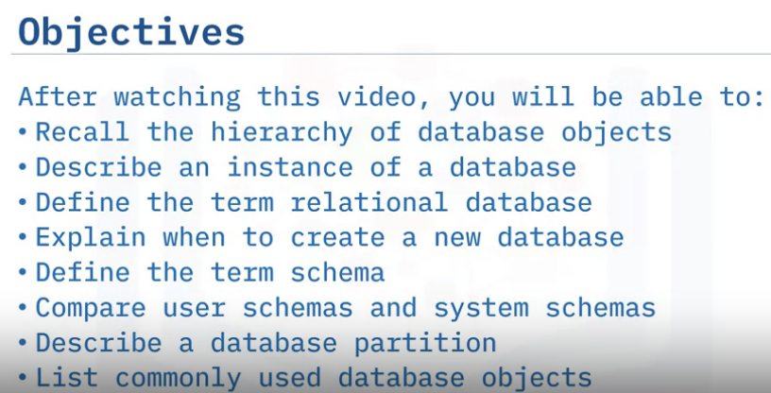
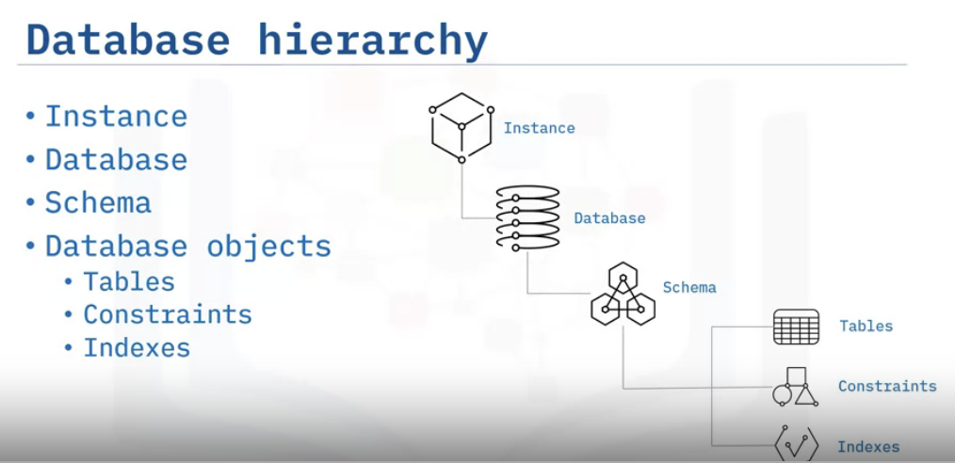
Database Objects & Hierarchy (Including Schemas)
Instances: an instance, a single way of organizing the database
and everything it contains. You can create more than 1 instance.
Database: Many RDBMSes permit more than one database within a single instance
Schema: You will generally find at least one schema at some level in the hierarchy. A schema is a
logical grouping of objects within a database. Schemas define how database objects are named
and prevent ambiguous references..
Database Objects: Some RDBMSs consider the schema a parent object of a database,
and others consider it a database object. Within a schema are the database objects,
including tables, constraints, and indexes

Slide 3
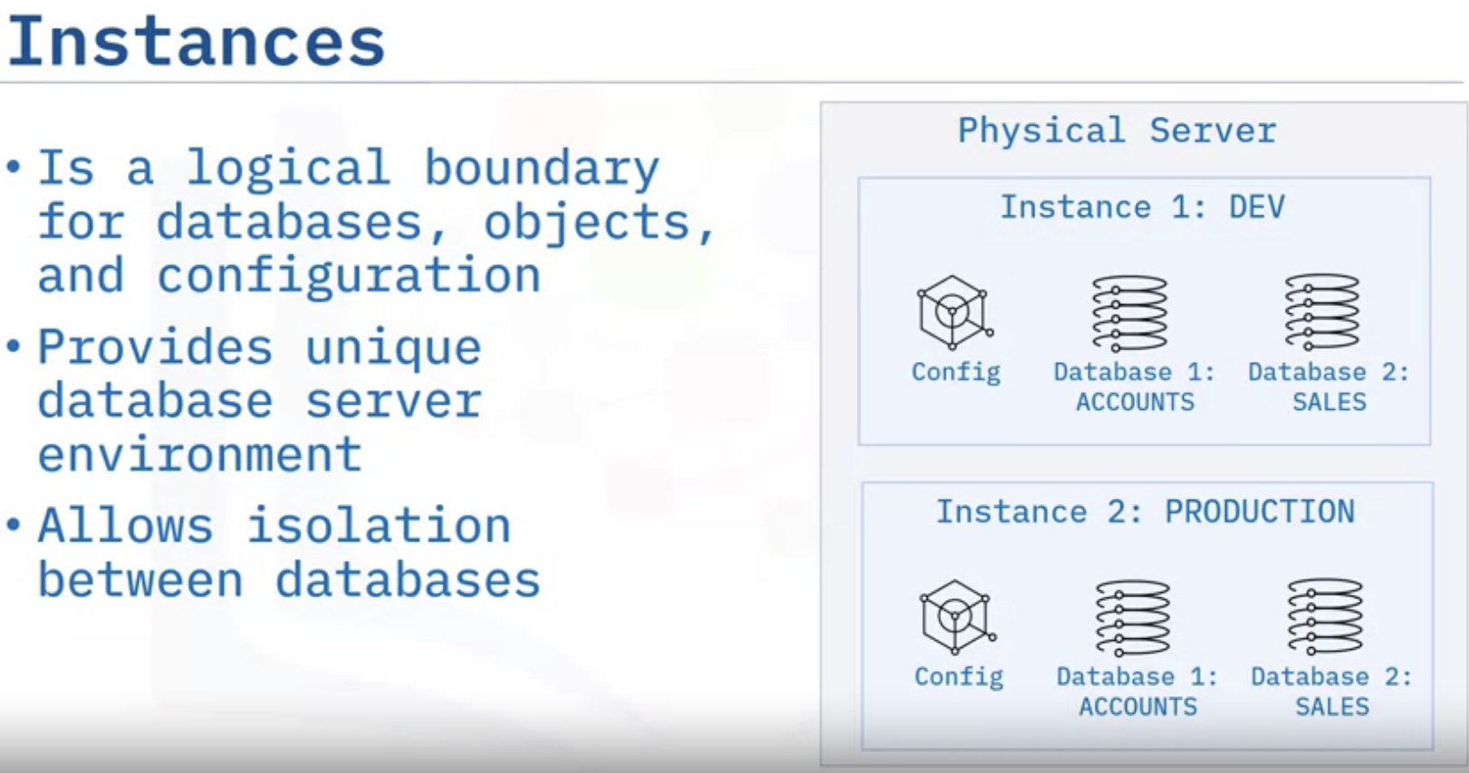

Slide 4
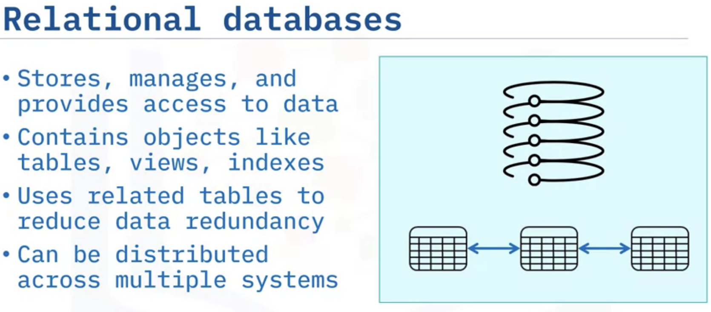

Slide 5
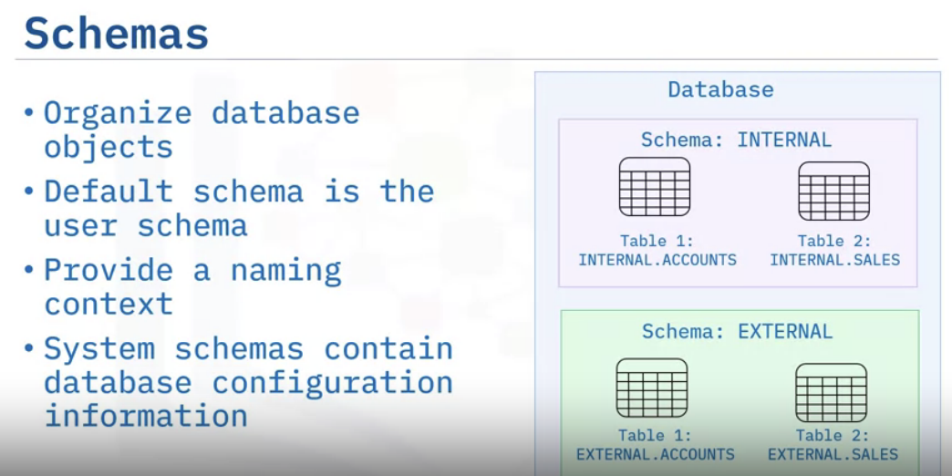

Slide 6
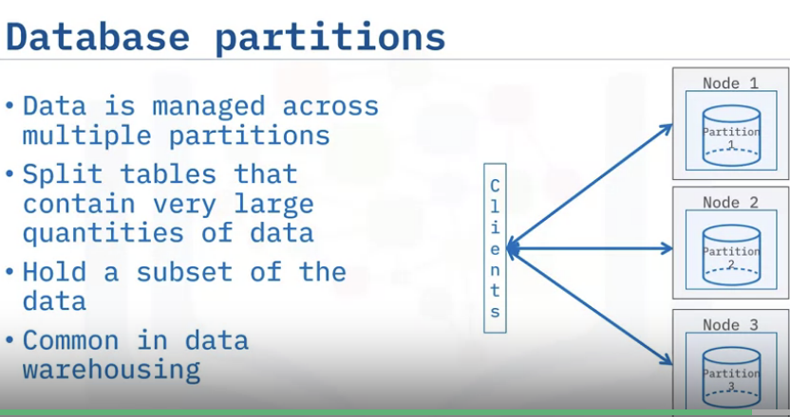

Slide 7
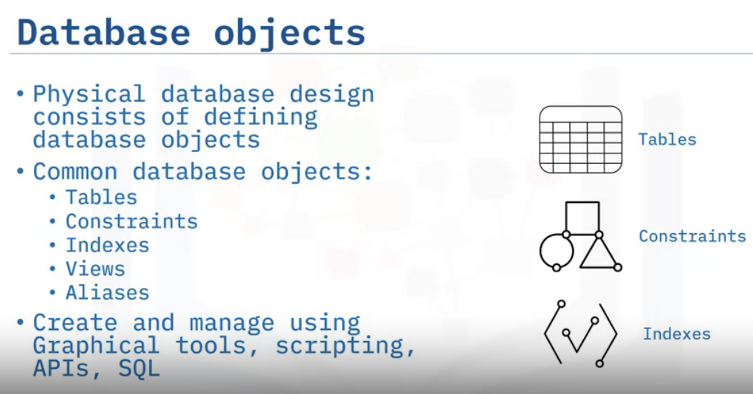

Slide 8
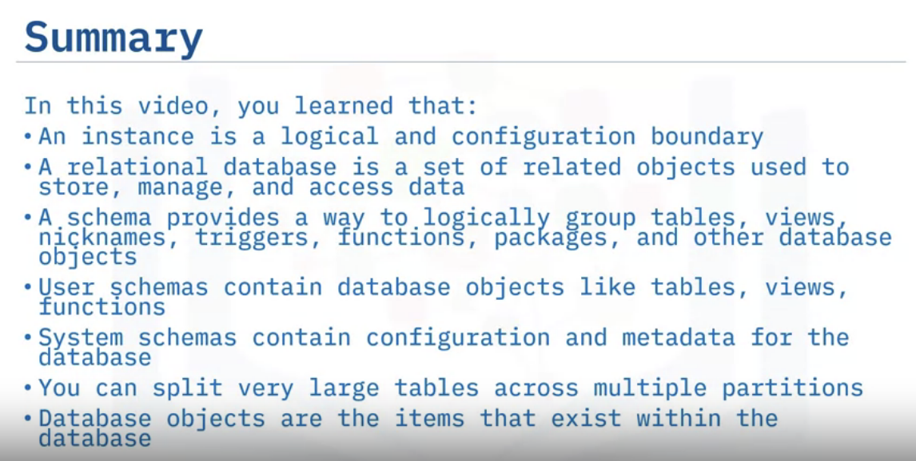
Such as Tables, Constraints, Views and Aliases.

Slide 9
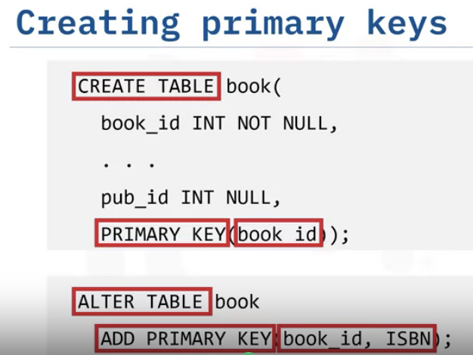
Primary Keys & Foreign Keys
Primary Key: A primary key is used to ensure that data in the specific column is unique. A column cannot have NULL values. It is either an existing table column or a column that is specifically generated by the database according to a defined sequence.
Example: Refer the figure – STUD_NO, as well as STUD_PHONE both, are candidate keys for relation STUDENT but STUD_NO can be chosen as the primary key (only one out of many candidate keys).
Foreign Key: A foreign key is a column or group of columns in a relational database table that provides a link between data in two tables. It is a column (or columns) that references a column (most often the primary key) of another table.
Example: Refer the figure – STUD_NO in STUDENT_COURSE is a foreign key to STUD_NO in STUDENT relation.
Objective:
Define primary & foreign keys
Create primary & foreign keys
Creating PK
for new table
Creating PK
on existing table

Slide 10
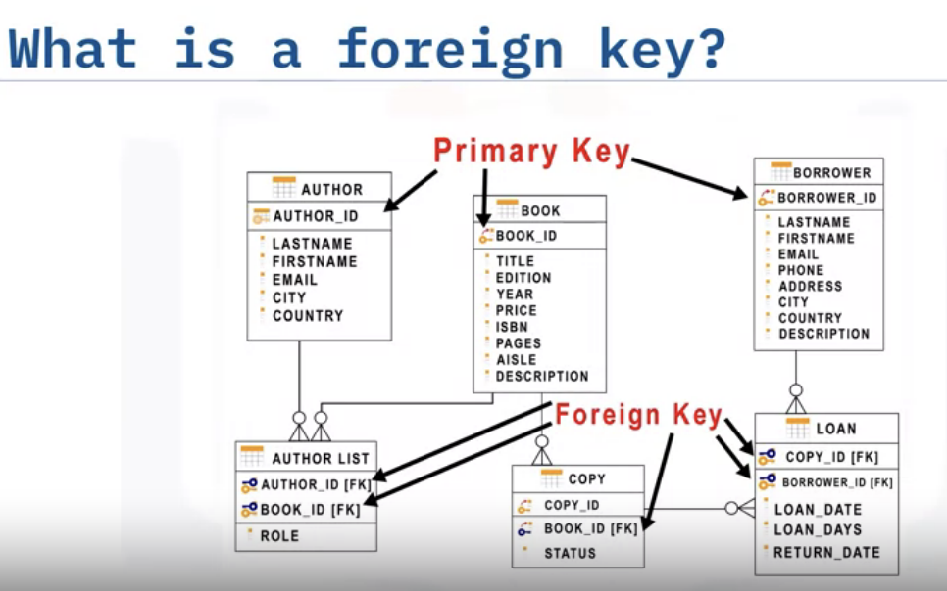
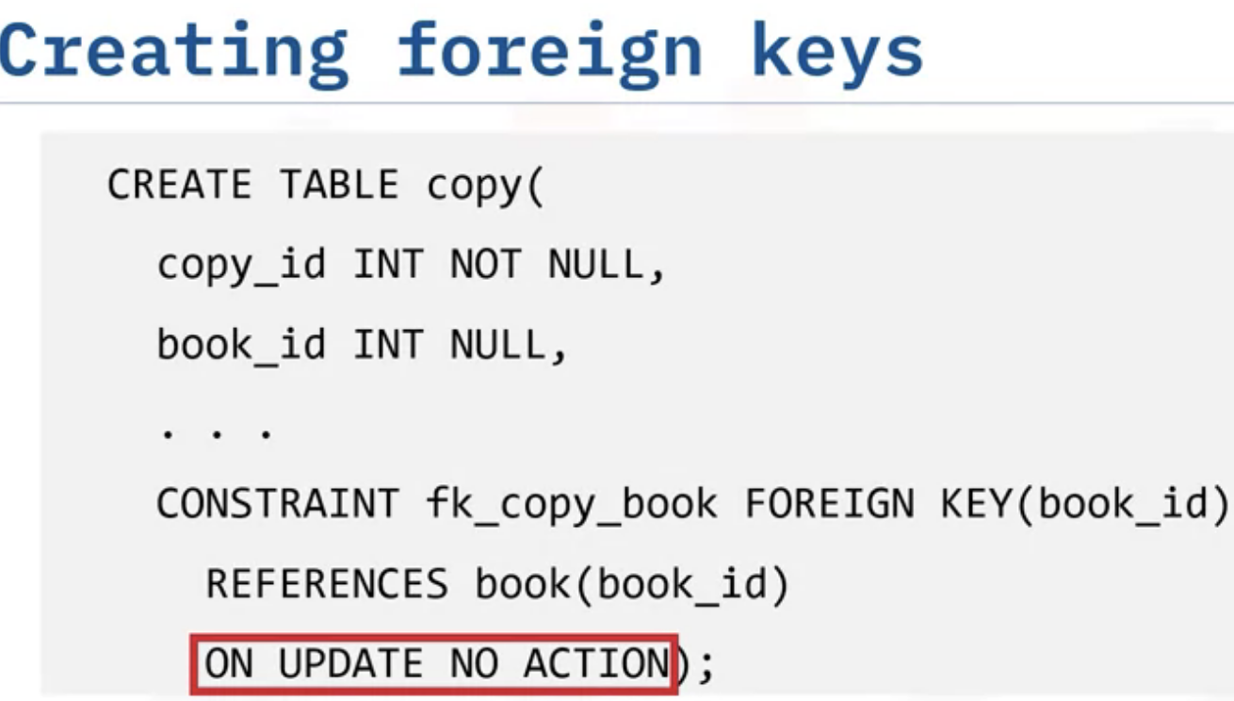

No change will be made
Cascade: delete the related
child rows in the dependent table, or to set the values in the foreign key column of the
child table to null

Slide 11
Difference between Primary Key and Foreign Key - GeeksforGeeks
S.NO. | PRIMARY KEY | FOREIGN KEY
1 | A primary key is used to ensure data in the specific column is unique. | A foreign key is a column or group of columns in a relational database table that provides a link between data in two tables.
2 | It uniquely identifies a record in the relational database table. | It refers to the field in a table which is the primary key of another table.
3 | Only one primary key is allowed in a table. | Whereas more than one foreign key are allowed in a table.
4 | It is a combination of UNIQUE and Not Null constraints. | It can contain duplicate values and a table in a relational database.
5 | It does not allow NULL values. | It can also contain NULL values.
6 | Its value cannot be deleted from the parent table. | Its value can be deleted from the child table.
7 | It constraint can be implicitly defined on the temporary tables. | It constraint cannot be defined on the local or global temporary tables.

Slide 12

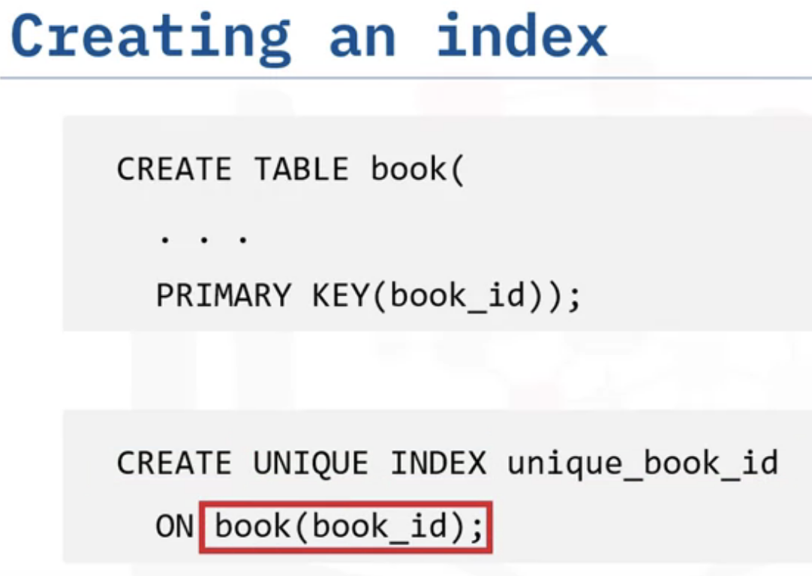
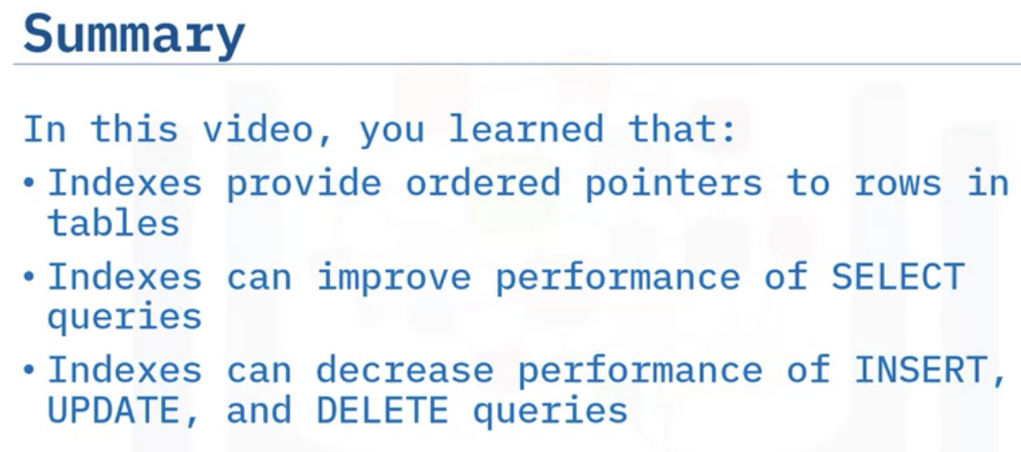
Indexing
SQL Index |¦| Indexes in SQL |¦| Database Index - YouTube

Slide 13
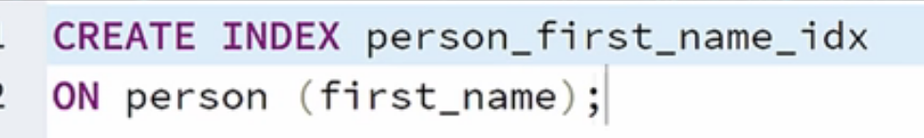
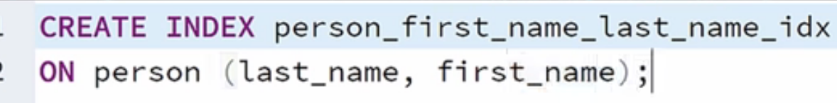
CREATE INDEX table-name_first-column_second-column_idx
ON table-name(first-column,last-column)

Slide 14
Normalization
Normalization is the process of organizing your data to reduce redundancy and inconsistency, often by dividing larger tables into multiple related tables.
Normalization helps speed up transactions because you perform updates, additions, and deletes only once on a normalized database.
It also improves data integrity because it reduces the chance of a change being made in one place but not in another.
As you begin the normalization process, it’s important to recognize that you focus on normalizing each table until you reach the required normal form level.
Normalization usually results in creating more tables, and once all the tables are normalized, you will have a normalized database.

Slide 15
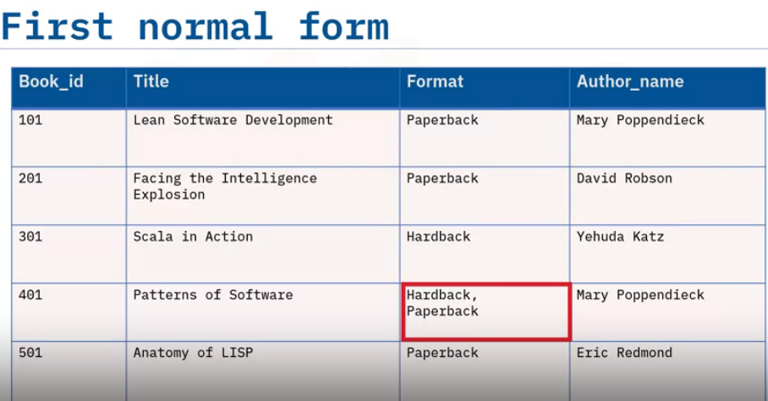
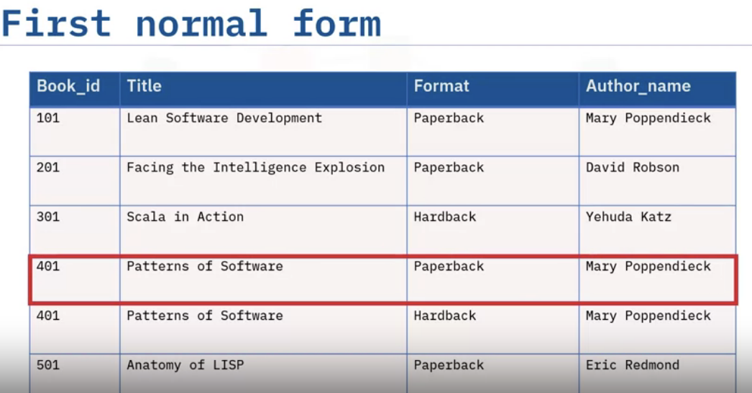
1NF: First Normal Form
Each row must be unique
Each cell must contain a single value
Highlighted cell contains multiple values as a list which must be removed for 1F.
1NF can be done by splitting that list into 2 separate rows.

Slide 16
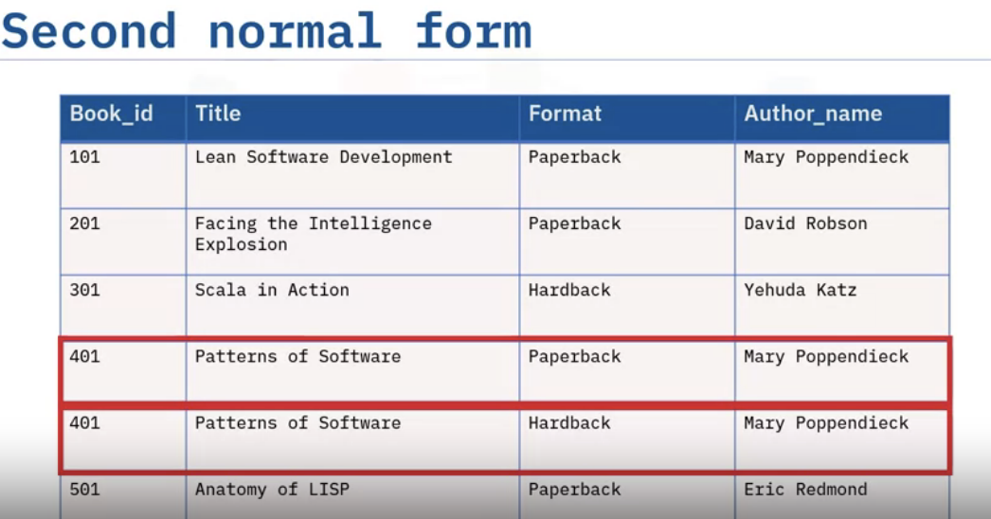
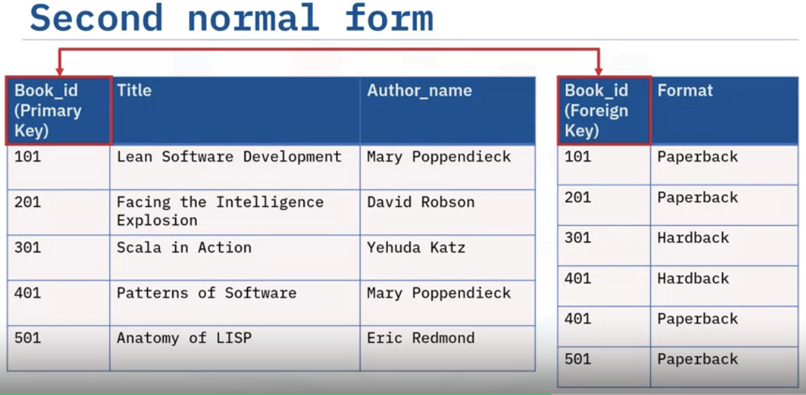
2NF : Second Normal Form
Database must be in 1NF
Create separate tables for sets of values that apply to multiple rows
There is a data duplication. ‘Format’ column has unique values, but rest of the vales are similar in highlighted 2 rows.
1NF is satisfied here, but for 2NF, separate table has to be created which apply to multiple rows (with identical values) with FK.

Slide 17
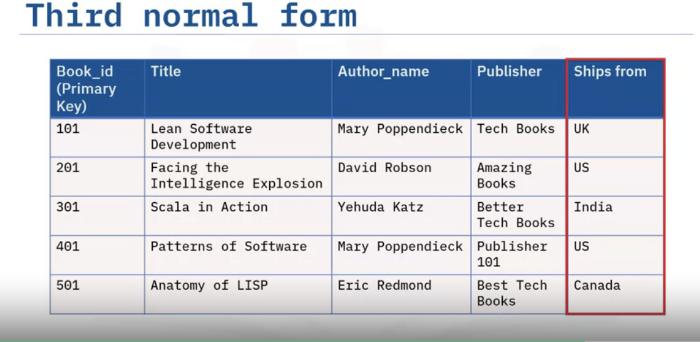
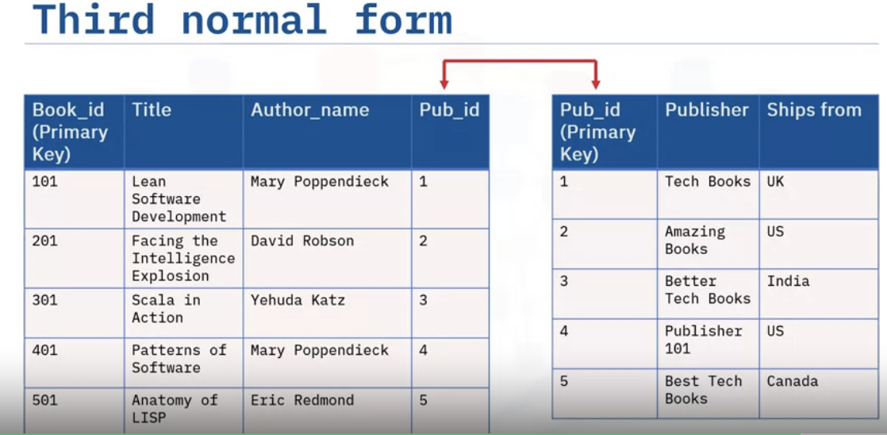
3NF : Third Normal Form
Database must be in 1NF & 2NF
Eliminate columns that do not depend on the key
From where the book ships , does not depend on the book_id(FK) and it depends on the publisher.
‘Ships_from’ must be removed from the ‘book’ table and linked with the separate table of ‘publisher’ data.

Slide 18

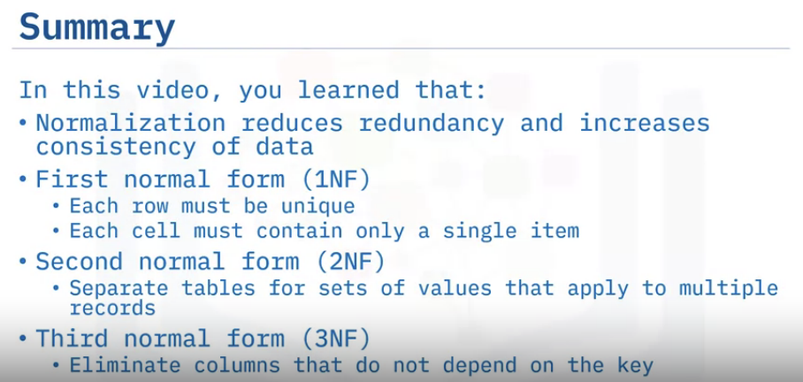
BCNF : Boyce Codd Normal form ( An extension of 3NF)

Slide 19
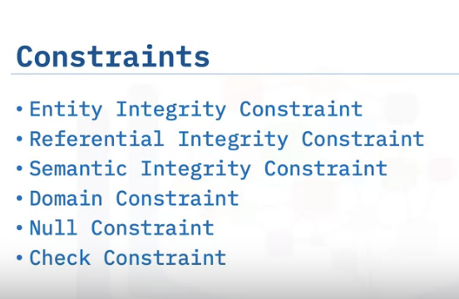
no attribute participating in the primary key of a relation is allowed to accept NULL values.
Defines relationships between tables and ensures that these relationships
remain valid.
refers to the correctness of the meaning of the data.
Specifies permissible values for a given attribute
Attribute values can not be NULL
Limits the values accepted by an attribute

Slide 20
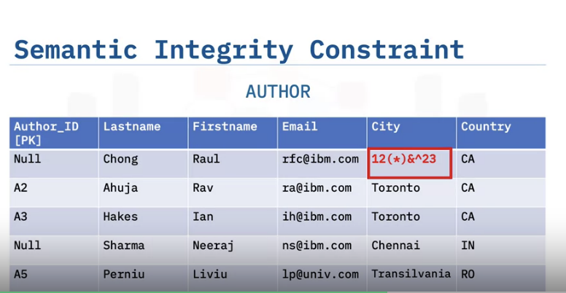
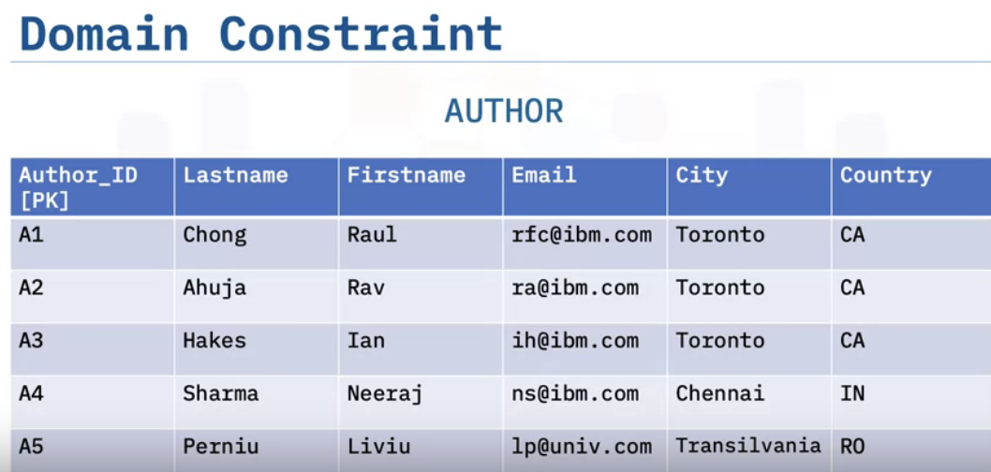
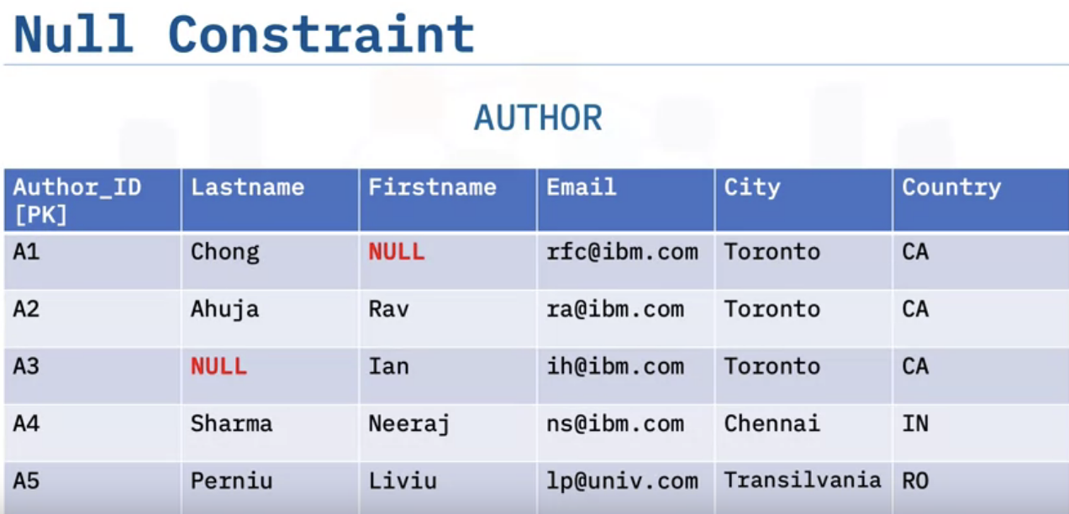
For the value of ‘city’, there is some garbage value which is not accepted.
In the relation Author, the attribute Country must contain a two-letter country code, such as CA for Canada, or IN for India.
If a number value of 34 is entered for the Country attribute instead of a two-letter country code, the value 34 does not having any meaning.
Value for the cell can not be NULL

Slide 21
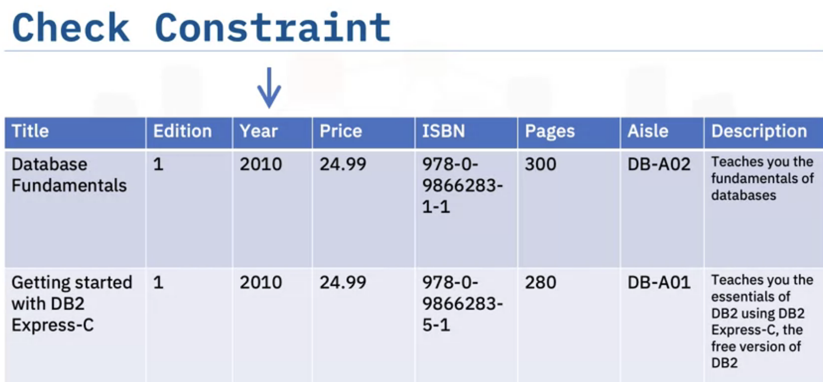
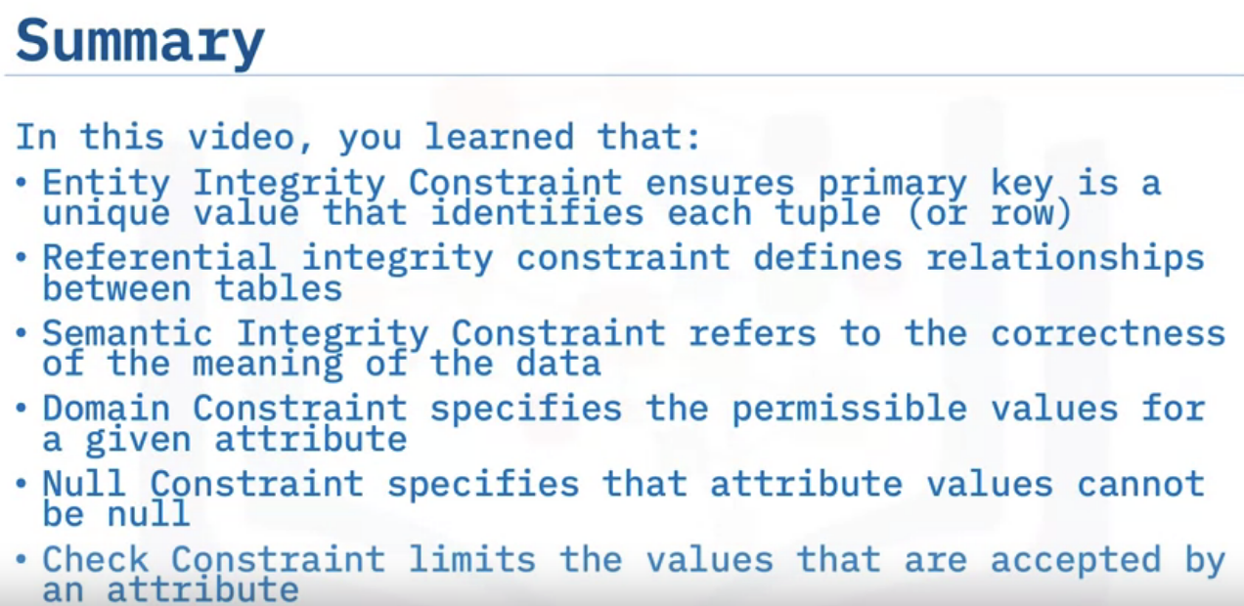
Book publication year can not be greater than the current year.

Slide 22
Summary & Highlights
The objects in a Relational Database Management System (RDBMS) object hierarchy include:
Instances. This is a logical boundary for a database or set of databases where you organize and isolate database objects and set configuration parameters.
Relational databases. This is a set of objects used to store, manage, and access data.
Schemas. A user or system schema is a logical grouping of tables, views, nicknames, triggers, functions, packages, and other database objects. Schemas provide naming contexts so that you can distinguish between objects with the same name.
Database partitions. You can split very large tables across multiple partitions to improve performance.
Database objects. Database objects are the items that exist within the database, such as tables, constraints, indexes, views, and aliases.
Primary key and Foreign Keys have several uses:
Primary keys enforce uniqueness of rows in a table, whereas Foreign keys are columns in a table that contain the same information as the primary key in another table.
You can use primary and foreign keys to create relationships between tables. Relationships between tables reduce redundant data and improve data integrity.
Indexes provide ordered pointers to rows in tables and can improve the performance of SELECT queries, but can decrease the performance of INSERT, UPDATE, and DELETE queries.

Slide 23
Normalization reduces redundancy and increases consistency of data. There are two forms of normalization:
First normal form (1NF). In this form, the table contains only single values and has no repeating groups.
Second normal form (2NF). This form splits data into multiple tables to reduce redundancy.
You can define six relational model constraints:
Entity integrity constraint. Ensures that the primary key is a unique value that identifies each tuple (or row.)
Referential integrity constraint. Defines relationships between tables.
Semantic integrity constraint. Refers to the correctness of the meaning of the data.
Domain constraint. Specifies the permissible values for a given attribute.
Null constraint. Specifies that attribute values cannot be null.
Check constraint. Limits the values that are accepted by an attribute.

